Slide 1
OutGoer
INB348 – Mobile App Development
Group “Cake”: Braydon Cohn & Jordan Hennell

Slide 2
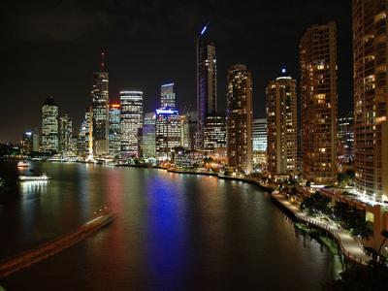
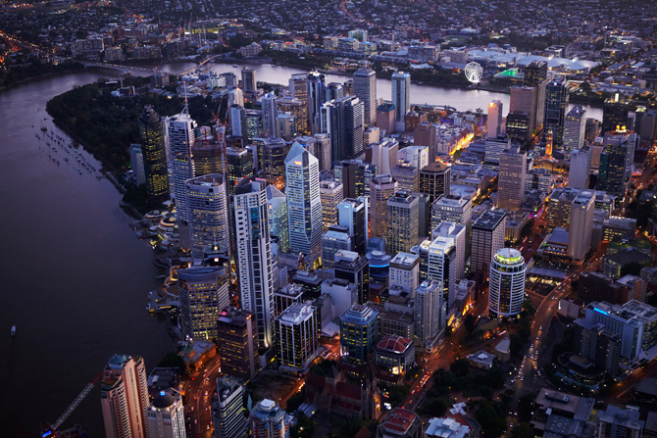
OutGoer
Background of Our App
Reduce communication barriers between travellers
Open up socialisation, creating a community
Streamlined experience that combines utility and navigation
What Is it?
Why Invest?
Forum-based mobile application
Users discuss Brisbane
Food, attractions, nightlife, shopping and general information
Showcases city in an easily digestible form
Quick access to information about the city
Easily extendable
Livingly Media, 2013
Brisbane Marketing, 2013

Slide 3
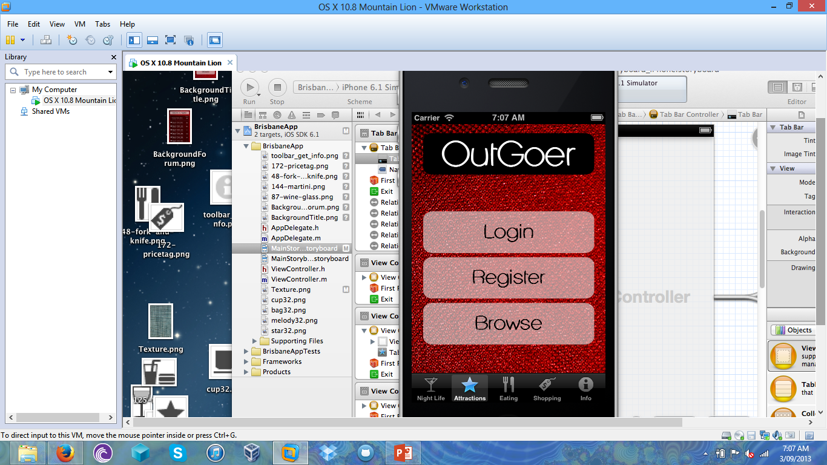
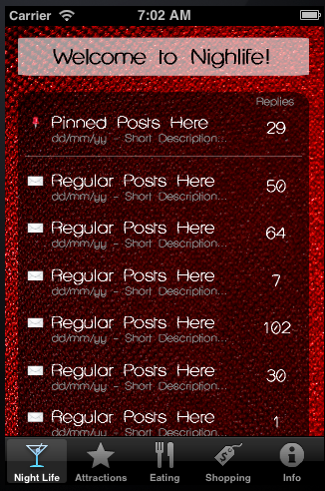
OutGoer
How It Will Look & Feel
Simple UI
Tabbed navigation while within forum
Different categories
Thread can be viewed by touching
Red, black, white
Must log in to contribute
Optional map for navigation

